Slide 1
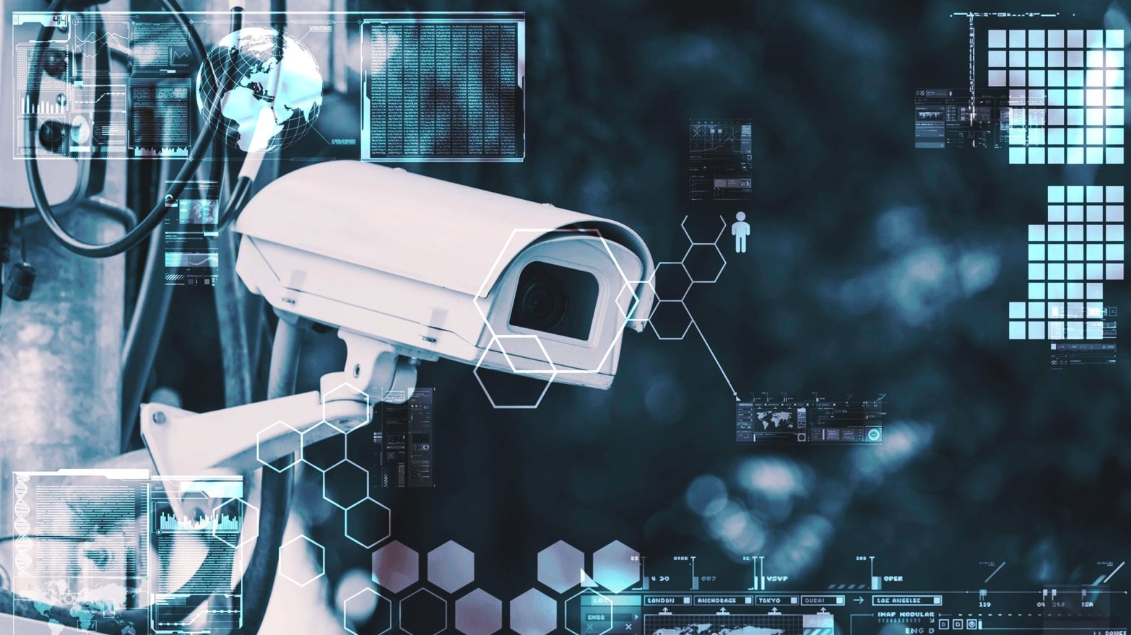

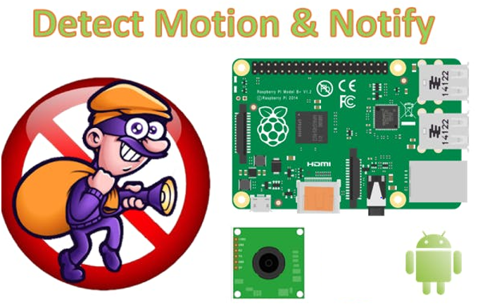
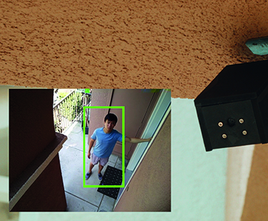
Raspberry Pi As Surveillance Camera (Keeping an eye on things)
Team member :
Haryanto (Taiwan)
Nakanishi Toshiki (Japan)
Katayama Riki (Japan)
Phan Cong Nghia (Vietnam)

Slide 2
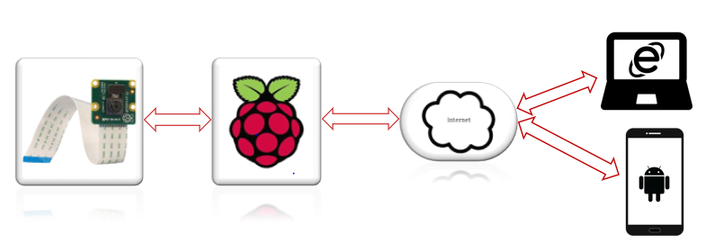
Block Diagram
Notes:
Control the gate
Each detect motion will take a picture and send to cloud.

Slide 3
OUR PROGRESS
Our job have done 50 %
What we have done:
Create server for camera live streaming
Create apps to access video
Motion detection
What we not finish:
Design apps be better
Control servo motor using camera sensor
Save video recording and picture in cloud

Slide 4
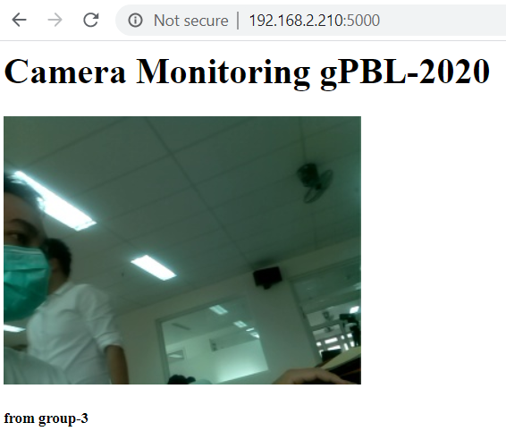
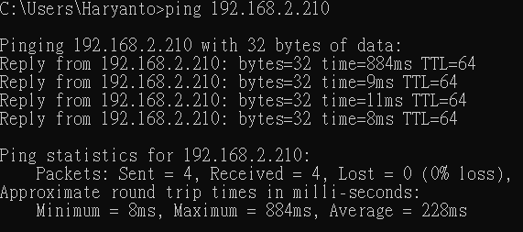
RaspberryPi as a server camera streaming

Slide 5
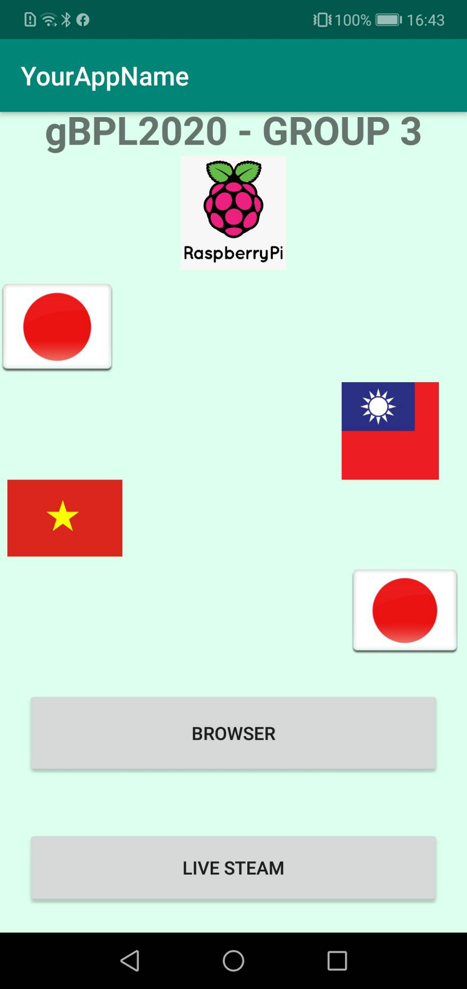
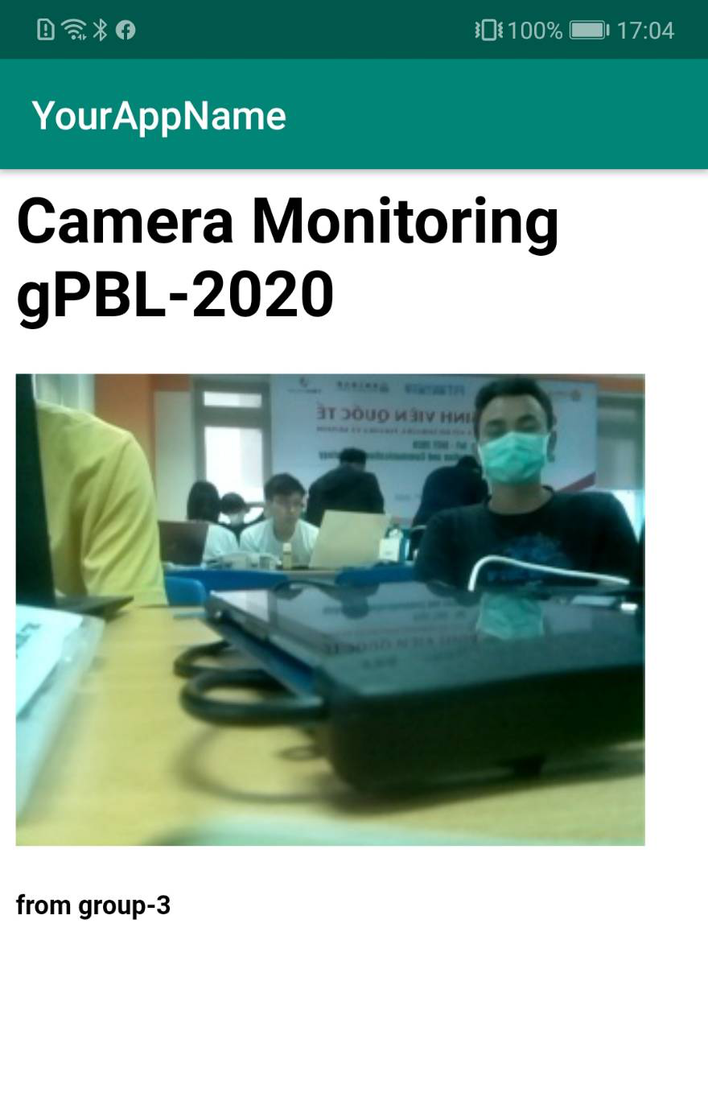
Create apps Android to access video
`

Slide 6
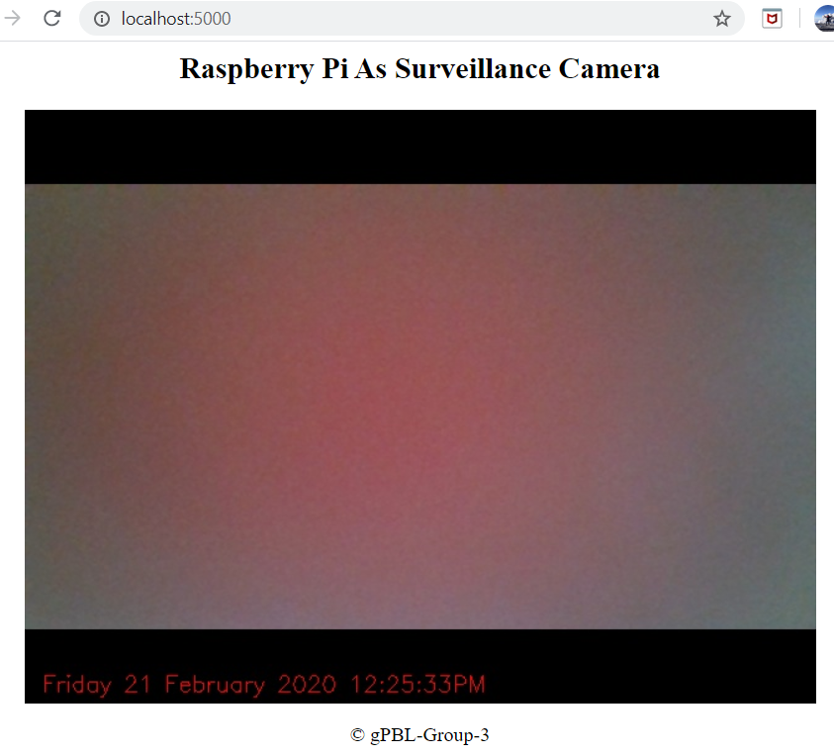
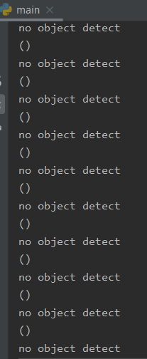
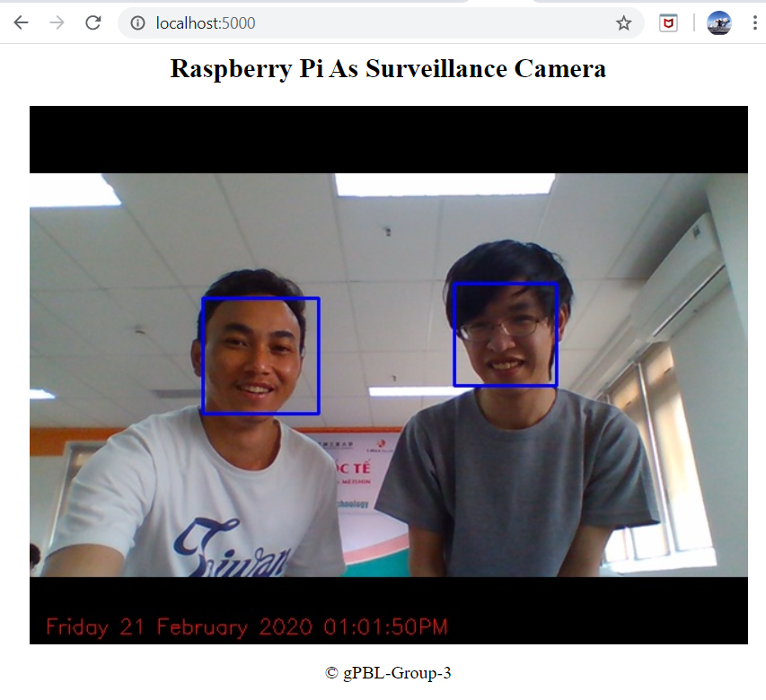
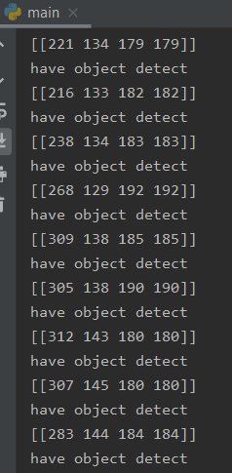
Motion detection

Slide 7

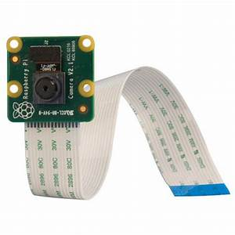

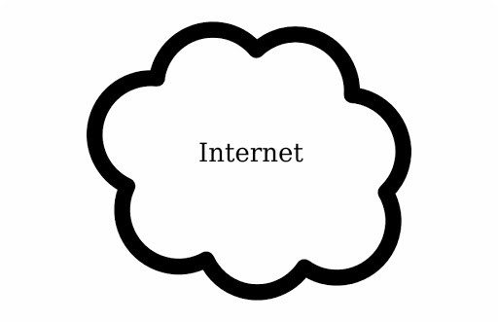

Raspberry Pi As Surveillance Camera
Team member :
Nakanishi Toshiki (Japan)
Katayama Riki (Japan)
Haryanto (Taiwan)
Phan Cong Nghia (Vietnam)

